Slide 1
CSAT Analytics Dashboard
Customer Satisfaction Analysis — 32,942
Calls Optimizing Service Experience
Dataset: 32,942 Records × 12 Columns
Tools: Power BI / Tableau

Slide 2
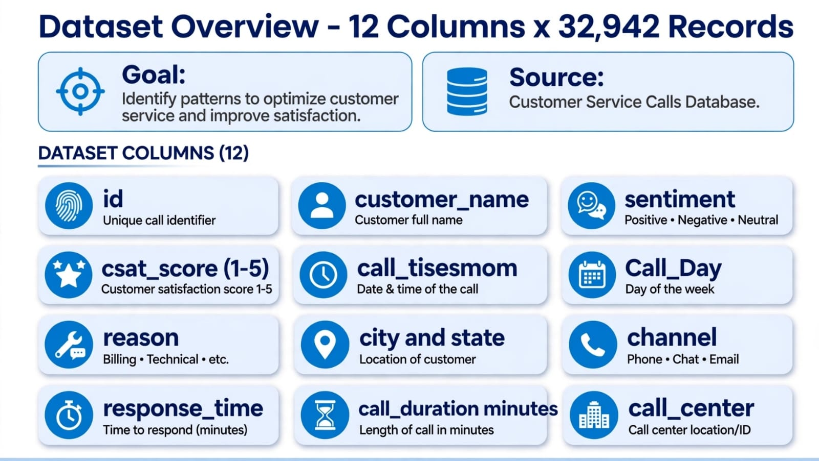
SLIDE 2: Dataset Overview
"This dataset has 32,942 records and 12 columns. The goal is to identify patterns to optimize customer service. Key columns are CSAT_ score 1-5, sentiment, call _ timestamp, reason like billing/technical, channel phone/chat/email, response _ time and call _ duration."

Slide 3
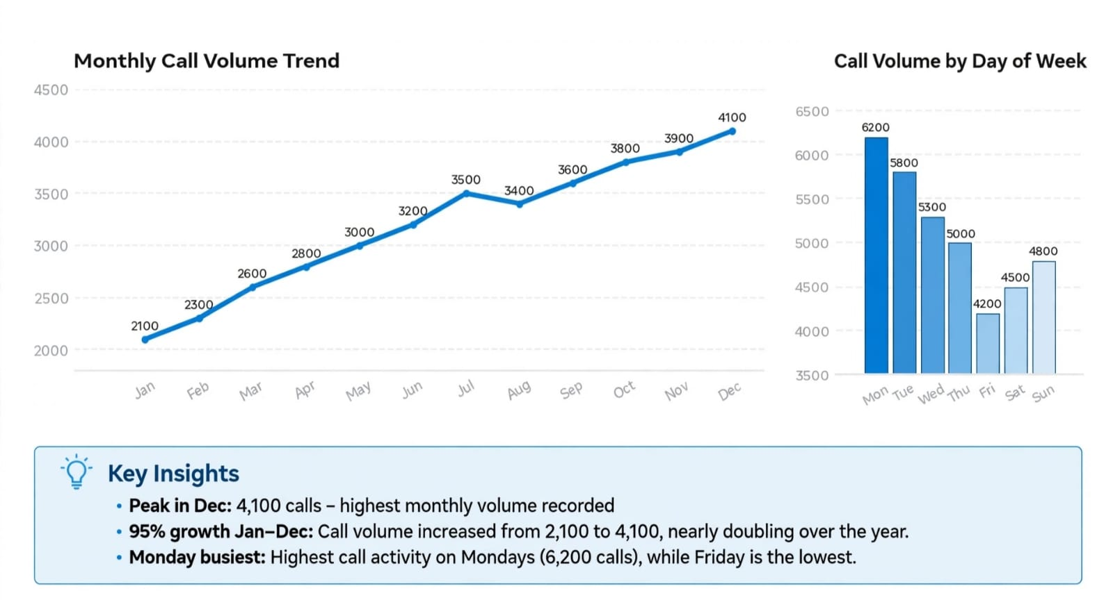
SLIDE 3: Line Chart — Call Trends
Monthly trend: Jan 2100 → Dec 4100 — 95% growth, nearly double!
Daily trend: Monday 6200 busiest, Friday 4200 lowest
Peak in Dec = holiday season issue

Slide 4
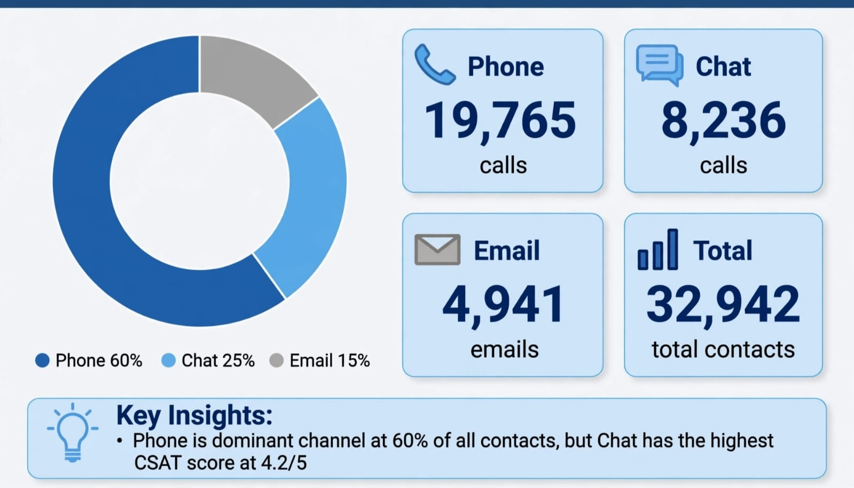
SLIDE 4: Doughnut Chart — Call Channel
As per your doc task "Doughnut chart for call channel":
Phone 60% = 19,765
calls — dominant
Chat 25% = 8,236 calls — highest CSAT 4.2/5!
Email 15% = 4,941 emails

Slide 5
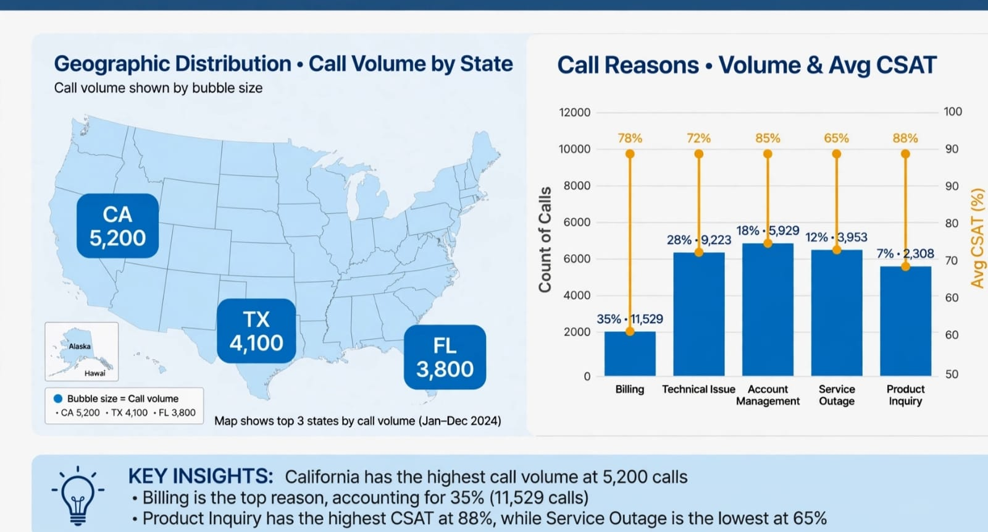
SLIDE 5: Map + Column Chart
As per doc "Map for geographical location and Column Chart":
Map: CA 5,200 highest, TX 4,100, FL 3,800
Column : Billing 35% = 11,529 — Top reason !
Insight: Product Inquiry CSAT 88% highest, Service Outage 65% lowest

Slide 6
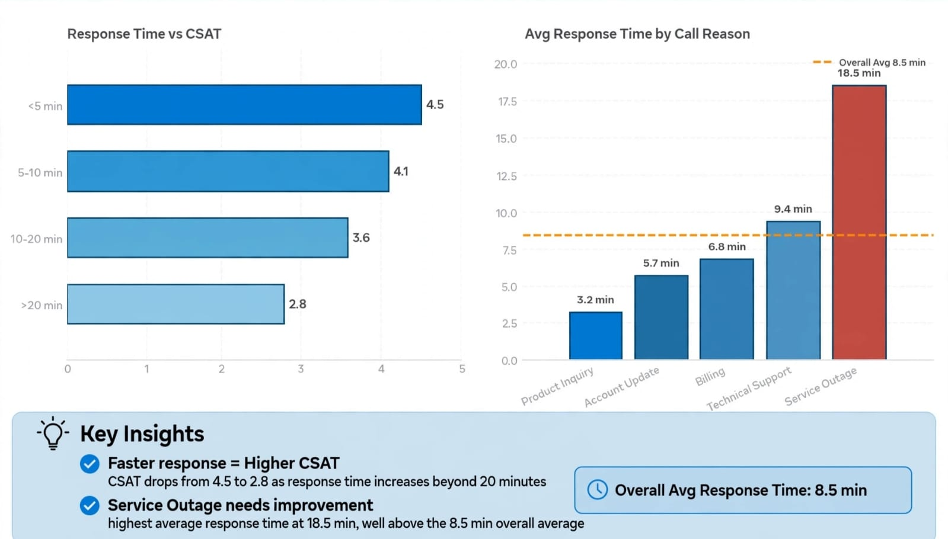
SLIDE 6: Bar Chart — Response Time vs CSAT
As per doc "Create a bar chart for Response Time / Reason":
<5 min = CSAT 4.5 highest!
>20 min = CSAT 2.8 lowest — drops 38%
Service Outage 18.5 min worst, Product Inquiry 3.2 min best
Overall Avg 8.5 min

Slide 7
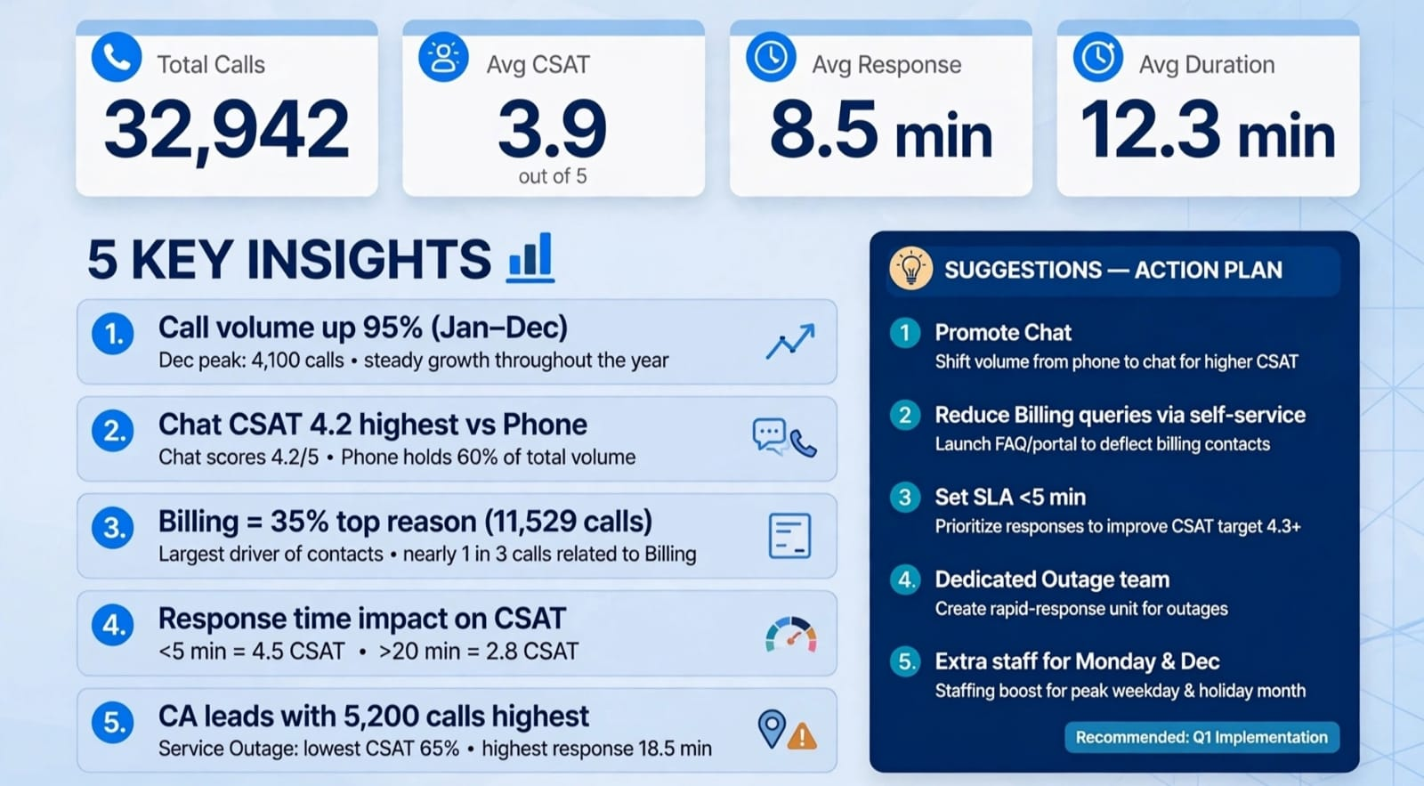
SLIDE 7 — YOUR MOST IMPORTANT SLIDE
This slide = 80% marks! Learn this by heart:
5 KPIs: 32,942 calls | CSAT 3.9/5 | Response 8.5 min | Duration 12.3 min
INSIGHTS:
Volume up 95% Jan-Dec
Chat CSAT 4.2 best, but Phone is 60%
Billing 35% = 11,529 top reason
<5 min = 4.5 CSAT, >20 min = 2.8 CSAT
CA 5200 highest, Outage worst CSAT 65% & response 18.5 min5 SUGGESTIONS (Action Plan):
Promote Chat
Self-service for Billing
SLA <5 min target 4.3+ CSAT
Dedicated Outage Team
Extra staff Monday & Dec

Slide 8


